Slide 1
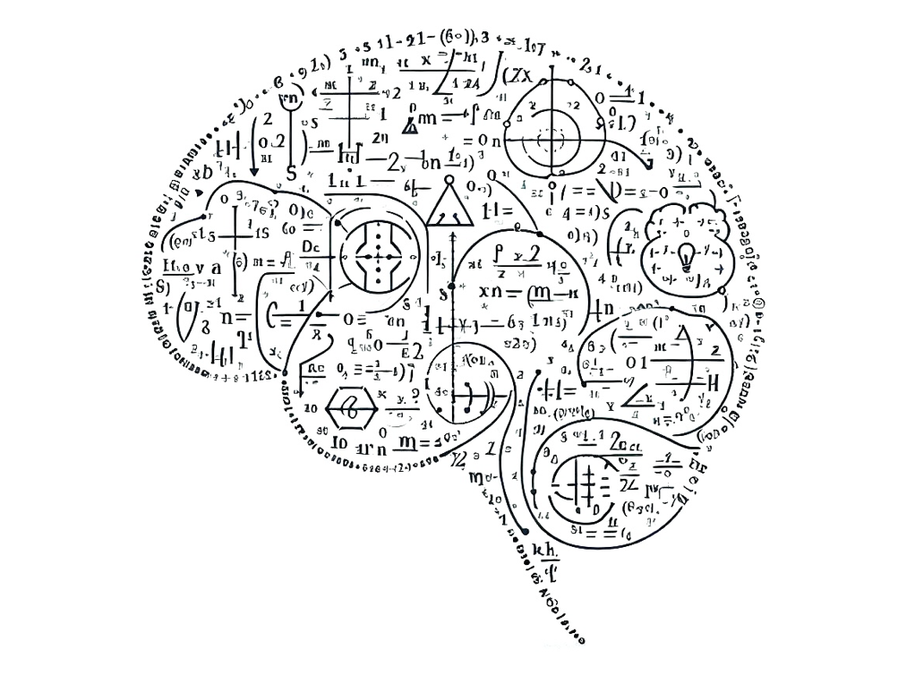
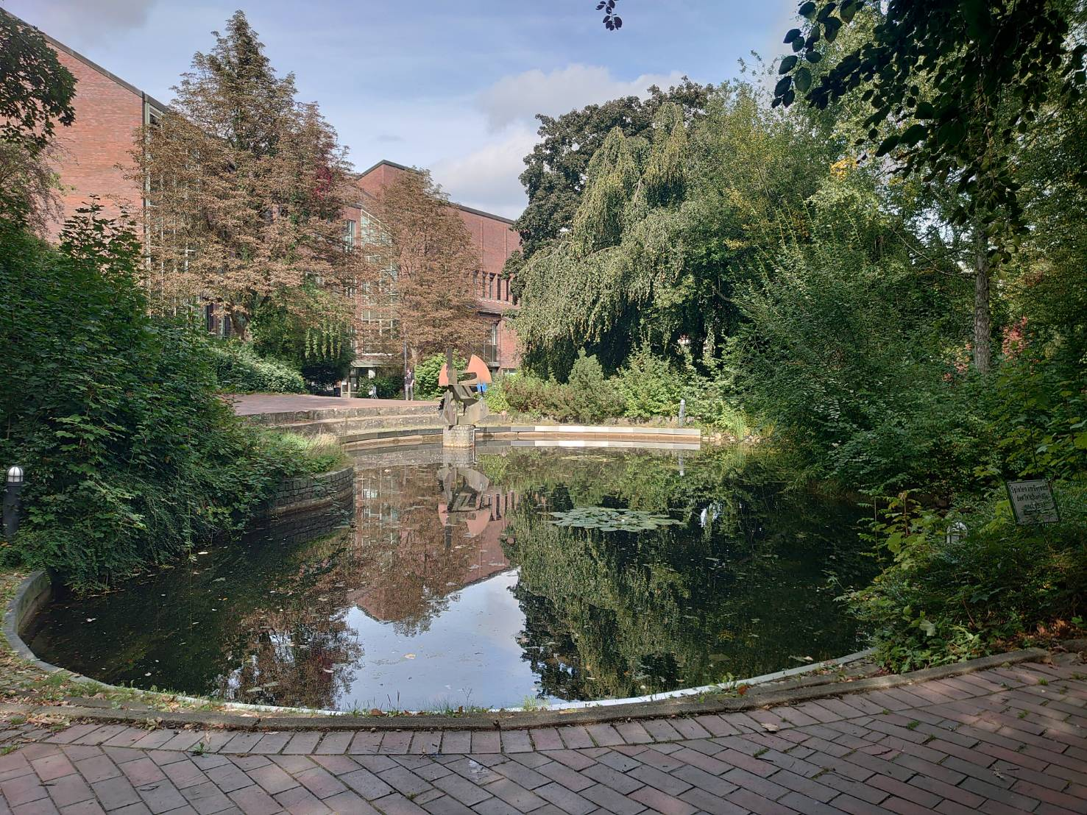

Some generalizations and perspectives on Bregman divergences
Frank Nielsen
Sony Computer Science Laboratories, Inc.
MML 2025 @ TUHH, Hamburg
September 24th, 2025
Notes:
14-1450: 35 slides
https://www.tuhh.de/dsf/mml
https://omlw2025.mlds.jp/
Fisher-Rao and Bregman manifolds: Some Applications in Machine Learning
Divergences and information geometry in machine learning

Slide 2
Outline: A collection of short stories!
Quick introduction to Bregman divergences
Duo Bregman pseudo-divergences
Curved Bregman divergences
Generalized Legendre transforms and information geometry
Generalized convexity and Bregman divergences
Boolean algebra of Bregman balls
Notes:
Statistical divergence reconstruction from integral-based Bregman generators
(truncated exponential families)
(Hessian submanifolds)
(moduli space of dually flat spaces)

Slide 3


Bregman divergences (1960’s): 1,2,3
① F: Θ⊆ℝ^{m}→ℝ strictly convex and smooth
Bregman divergence B_{F} : Θ x Relative Interior(Θ) →ℝ_{≥0}
Lev M. Bregman
(1941 - 2023)
Photo: courtesy of
Alexander Fradkov
B_{F}(θ₁ : θ₂) := F(θ₁)-F(θ₂)-< θ₁ - θ_{2 ,} ∇F(θ₂) >
Smooth measure of discrepancy, not a metric distance because it violates the triangle inequality and
is asymmetric when F is not quadratic function.
② BD = remainder of a first order Taylor expression of F(θ₁) around θ₂:
F(θ₁) = F(θ₂)+< θ₁ - θ_{2 ,} ∇F(θ₂) >+ B_{F}(θ₁ : θ₂)
Taylor remainder
③ Example: Lagrange remainder (smooth C² generators): ∇²F SPD ⇒ B_{F}(θ₁ : θ₂) ≥ 0
B_{F}(θ₁ : θ₂)= ½ (θ₂- θ₁)^{T} ∇²F(θ) (θ₂- θ₁) ≥0 , ∃ θ ∈ [θ₁ θ₂] (squared Mahalanobis/Euclidean)
Notes:
real-valued function on a finite dimensional Hilbert space <.,.>
Hence the delimiter notation “:” instead of B_{F}(θ₁ , θ₂)
① ② ③
https://en.wikipedia.org/wiki/Mathematical_operators_and_
ℝ
① ② ③
symbols_in_Unicode
Θθ∇≻ξ∈
http://lib.physcon.ru/doc?id=5d34ad008433
Σ
Lev Meerovich Bregman
(1941 - 2023)

Slide 4
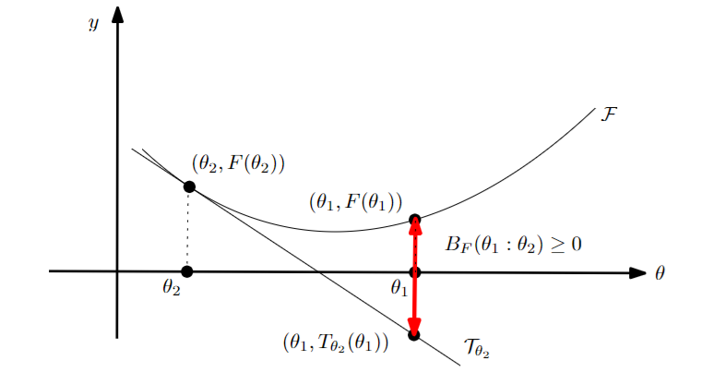
Geometric interpretation as a vertical gap using the graph (θ,F(θ)):
B_{F}(θ₁ : θ₂) = F(θ₁) - (F(θ₂)+< θ₁ - θ_{2 ,} ∇F(θ₂) >)
= T_{θ2}(θ₁) : Tangent of the function graph at θ₂ evaluated at θ₁

Slide 5



Bregman divergence:
B_{F}(θ₁ : θ₂) = F(θ₁) - F(θ₂)-< θ₁ - θ_{2 ,} ∇F(θ₂) >
How deep does a diver needs to dive vertically at θ₁ to see the starfish on the rock at θ₂ ?

Slide 6



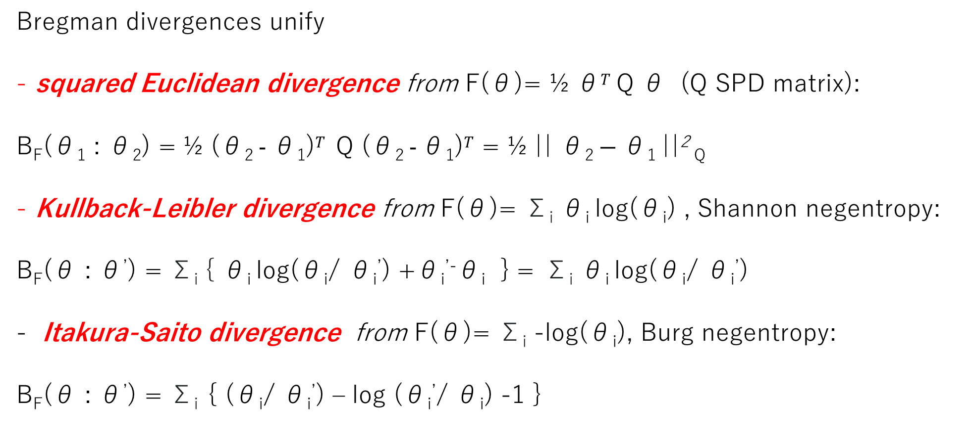
Bregman divergences: Versatile class of dissimilarities
Bregman divergences unify
squared Euclidean divergence from F(θ)= ½ θ$T$ Q θ (Q SPD matrix):
B_{F}(θ₁ : θ₂) = ½ (θ₂ $- \text{θ}\text{1}\text{)}T$ Q (θ₂ $- \text{θ}\text{1}\text{)}T$ = ½ || θ₂ $− \text{θ}\text{1} \text{||}$² _{Q}
Kullback-Leibler divergence from F(θ)= Σ_{i} θ_{i} log(θ_{i}) , Shannon negentropy:
B_{F}(θ : θ’) = Σ_{i} { θ_{i} log(θ_{i}/ θ_{i}’) +θ_{i}^{’-}θ_{i} } = Σ_{i} θ_{i} log(θ_{i}/ θ_{i}’)
Itakura-Saito divergence from F(θ)= Σ_{i} -log(θ_{i}), Burg negentropy:
B_{F}(θ : θ’) = Σ_{i} { (θ_{i}/ θ_{i}’) – log (θ_{i}’/ θ_{i}) -1 }

Slide 7
Families of Bregman divergences: β-divergences
squared Euclidean divergence
Kullback-Leibler divergence
Itakura-Saito divergence
Generator F_{β}(θ)= θ^{β}/(β(β-1)) – θ/ (β-1) + 1/ β
β-divergence: B_{Fβ}(θ₁: θ₂)= θ₁ ^{β+} (β-1) θ₂ ^{β}- β θ₁ θ₂ ^{β-1}
Learn/tune scalar parameterβ depending on applications
β=2
β=1
β=0
Notes:
β-divergences, learn β

Slide 8
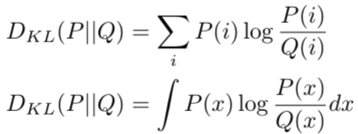

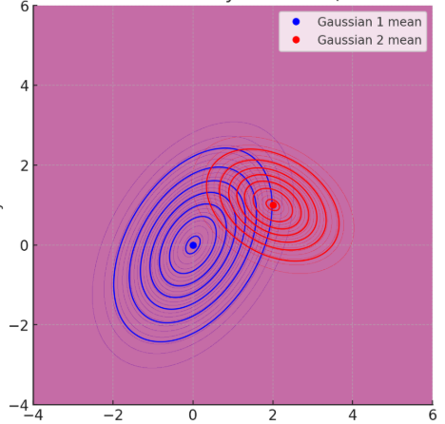
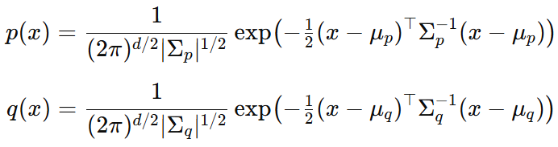
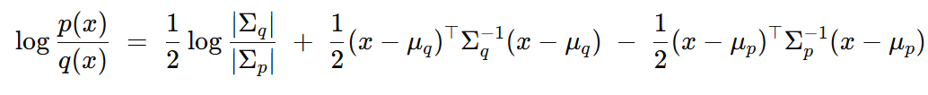
Relative entropy between Gaussian distributions?
Relative entropy = cross-entropy minus entropy, a dissimilarity measure in information theory, statistics, ML, etc.
called Kullback-Leibler divergence in information theory:
How to calculate the KLD between multivariate Gaussian distributions?
D_{KL}[p(x):q(x)]= ∫ p(x) log (p(x)/q(x)) dμ(x)
KLD integrals ∫ is non-trivial but….
Expectation of this term?
Notes:
a f-divergence for f(u)=-log u

Slide 9

Bregman divergences in ML: Exponential families
Kullback-Leibler divergence between two probability densities:
D_{KL}[p(x):q(x)]= ∫ p(x) log (p(x)/q(x)) dμ(x)
can be difficult to calculate in closed form because of the integral ∫
But Kullback-Leibler divergence between two probability densities of an exponential family with densities p(x| θ) = exp( <t(x), θ >-F(θ) )
amount to a reverse Bregman divergence B_{F}^{rev}(θ₁ : θ₂) := B_{F}(θ₂ : θ₁)
where F is the cumulant function (log partition/log Laplace function)
D_{KL}[p(x|θ₁) : p(x|θ₂) ] = B_{F}^{rev}(θ₁ : θ₂) = B_{F}(θ₂ : θ₁)
BDs wrt CFs between parameters = reverse KLD distributions
⇒ Easy calculations of KLDs
Bypass the ∫, ∇F in BD easy to calculate!
Azoury, Katy S., and Manfred K. Warmuth. "Relative loss bounds for on-line density estimation with the exponential family of distributions." Machine learning 43 (2001)
Notes:
∫μ
∇F easy!
Information geometry proves that B_{F}(θ₁ : θ₂)= D_{KL}*[p(x|θ₁) : p(x|θ₂) ]
when F(θ)=log ∫ exp(<x, θ >) dμ(x) where D_{KL}*[p(x):q(x)]:= D_{KL}[q(x):p(x)] is the reverse Kullback-Leibler divergence

Slide 10
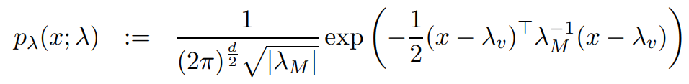
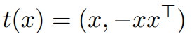
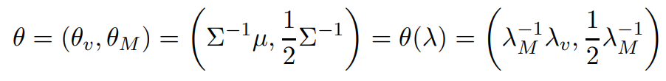
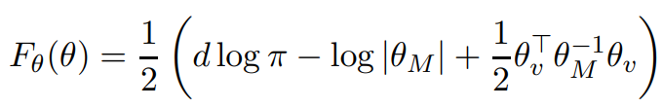
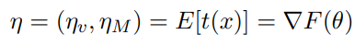
Example: KLD between Gaussians from BD

Slide 11
Kullback-Leibler divergence between non-normalized exponential family densities
Kullback-Leibler divergence between two positive measures:
D_{KL}⁺[q₁(x):q₂(x)] = ∫ { q₁(x) log (q₁(x)/q₂(x))+ q₂(x)-q₁(x) } dμ(x)
Exponential family density: Normalized p(x| θ) = exp(<x, θ >-F(θ)) dμ(x) versus non-normalized: q(x| θ) = exp(<x, θ >) dμ(x)
Hence, p(x| θ)= q(x| θ)/Z(θ) with partition function Z(θ)=exp(F(θ)) and cumulant function F(θ)=log Z(θ). When F is convex, Z=exp(F) is log-convex, and log-convex functions are also convex functions:
Both F and Z are convex functions, yields Bregman divergences B_{F} & B_{Z}
Well-known: KLD between normalized densities = reverse Bregman wrt F:
D_{KL}[p_{θ1}(x):p_{θ2}(x)] = B_{F}*[θ₁: θ₂] = B_{F}[θ₂: θ₁]
New: KLD between non-normalized densities = reverse Bregman wrt Z:
D_{KL}⁺[q_{θ1}(x):q_{θ2}(x)] = B_{Z}*[θ₁: θ₂] = B_{Z}[θ₂: θ₁]
2312.12849

Slide 12
Outline
A quick introduction to Bregman divergences
Duo Bregman pseudo-divergences
Curved Bregman divergences
Generalized Legendre transforms and information geometry
Generalized convexity and Bregman divergences
Space of Bregman balls
Notes:
Statistical divergence reconstruction from integral-based Bregman generators
(truncated exponential families)
(Hessian submanifolds)
(moduli space of dually flat spaces)

Slide 13
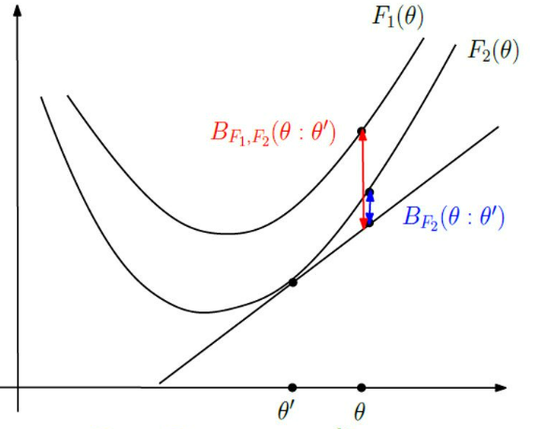
Duo Bregman divergences: Generalize BDs with a pair of generators
One generator majorizes the other one:
F₁(θ) ≥ F₂(θ)
Duo Bregman pseudo-divergence:
B_{F1,F2}(θ’’:θ’’)
≥ B_{F2}(θ: θ’)
θ’’
Recover Bregman divergence when F₁(θ) = F₂(θ) = F(θ)
Only pseudo-divergence because B_{F1,F2}(θ’’: θ’’) positive, not zero.
B_{F}(θ₁ : θ₂)=F(θ₁)-F(θ₂)-< θ₁ - θ_{2 ,} ∇F(θ₂)>
But why considering two generators?
Notes:
≥ B_{F}(θ: θ’)

Slide 14
KLD between nested exponential families amount to duo Bregman pseudo-divergences
q(x| θ)» p(x| θ)
p(x| θ)
X₁
X₂
q(x| θ)
Consider an exponential family on support X₁:
p(x| θ) = exp(<x, θ >-F₁(θ)) dμ(x)
with cumulant function F₁(θ)=log ∫_{X1} exp(<x, θ >) dμ(x)
Truncated exponential family with nested supports: X₁ ⊆ X₂
q(x| θ) = exp(<x, θ >-F₂(θ)) dμ(x)
is an exponential family with F₂(θ)=log ∫_{X2} exp(<x, θ >) dμ(x) ≥ F₁(θ)
Then KLD amounts to a reverse duo Bregman pseudo-divergence:
D_{KL}[p(x| θ₁) : q(x| θ₂) ] = B_{F2,F1}^{rev}(θ_{1:} θ₂) = B_{F2,F1}(θ₂: θ₁)
D_{KL}[p(x):q(x)]= ∫ p(x) log (p(x)/q(x)) dμ(x)
0 log(0/0)=0
"Statistical divergences between densities of truncated exponential families with nested supports: Duo Bregman and duo Jensen divergences." Entropy 24.3 (2022)
Notes:
»
Nielsen, Frank. "Statistical divergences between densities of truncated exponential families with nested supports: Duo Bregman and duo Jensen divergences." Entropy 24.3 (2022): 421.

Slide 15
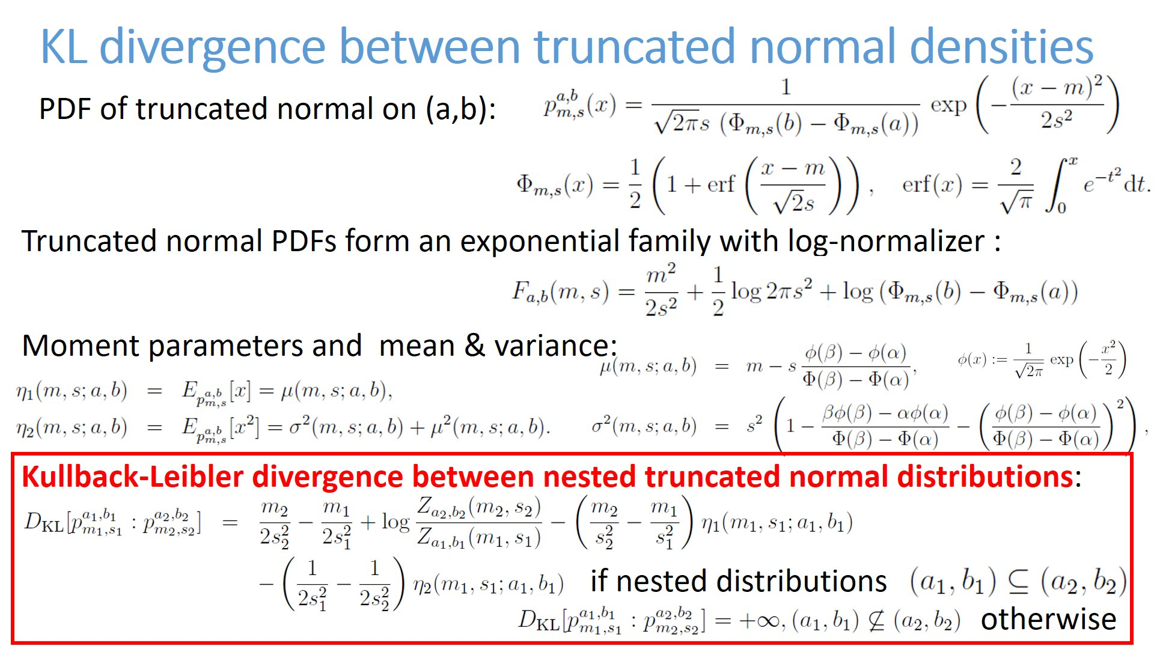
This is an example, DO NOT READ!
For illustration purpose!

Slide 16
Convex duality via Legendre-Fenchel transform
Convex duality: Legendre-Fenchel transform of a convex function F:
F*(η)=sup _{θ ∈ ϴ} { < θ, η >-F(θ) }
Problem: some tricky functions with gradient map ∇F domain not convex…
Example: on upper plane domain Ξ=(ξ₁, ξ₂)
Thus, we consider “nice convex functions” = Legendre-type functions (ϴ,F(θ))
(i) ϴ open, and (ii) lim _{θ→ ∂ϴ} ‖ ∇F (θ) ‖=∞
Then we get:
❶ reciprocal gradient maps : η= ∇F (θ), and θ=∇F* (η) and ∇F*=(∇F)⁻¹
❷ conjugation yields (H,F*(η)) of Legendre type
❸ biconjugation is an involution: (H,F*(η))*= (H*=ϴ,F**=F(θ))
Convex conjugate: F*(η) = < ∇F⁻¹ (η), η >-F(∇F⁻¹(η)) since η= ∇F (θ)
Notes:
η → ‖ ∞

Slide 17
Fenchel-Young divergences & convex duality
Young inequality: F (θ₁)+F* (η₂)≥ < θ_{1 ,} η₂> with equality iff η₂ = ∇F (θ₁)
Build the Fenchel-Young divergence from inequality gap lhs-rhs ≥0
Y_{F, F*}(θ_{1,} η₂) := F (θ₁)+F* (η₂)-< θ_{1 ,} η₂> ≥ 0
BD with mixed parameterizations θ and η : B_{F}(θ₁ : θ₂)= Y_{F, F*}(θ_{1,} η₂)
Duality: Four equivalent expressions of the “Bregman divergence”
B_{F}(θ₁ : θ₂)= Y_{F, F*}(θ_{1,} η₂) = Y_{F*,F}(η_{2 ,}θ₁)= B_{F*}(η_{2 ,} η ₁)
Dual BDs + Dual FYs from involution F**=F
Note： B_{F}(θ₁ : θ₂ )=0 ⇔ θ₁ = θ₂ ⇔ η₁ =η ₂ i.e., ∇F(θ₁) = ∇F(θ₂)
Notes:
Amari, Shun-ichi. Differential-geometrical methods in statistics. Vol. 28. Springer, 1985

Slide 18
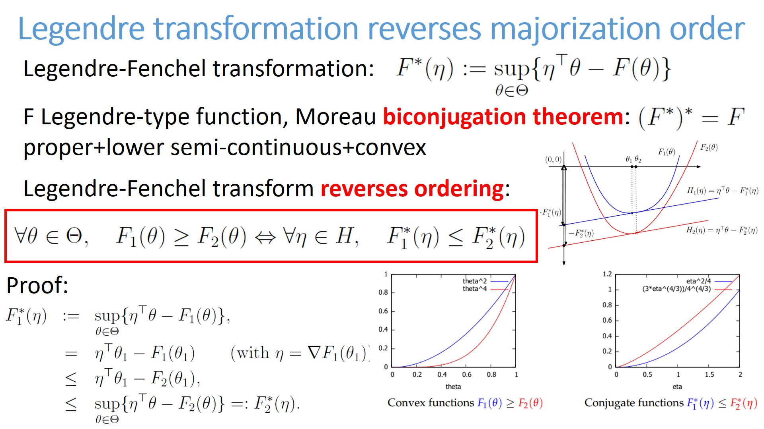

Slide 19
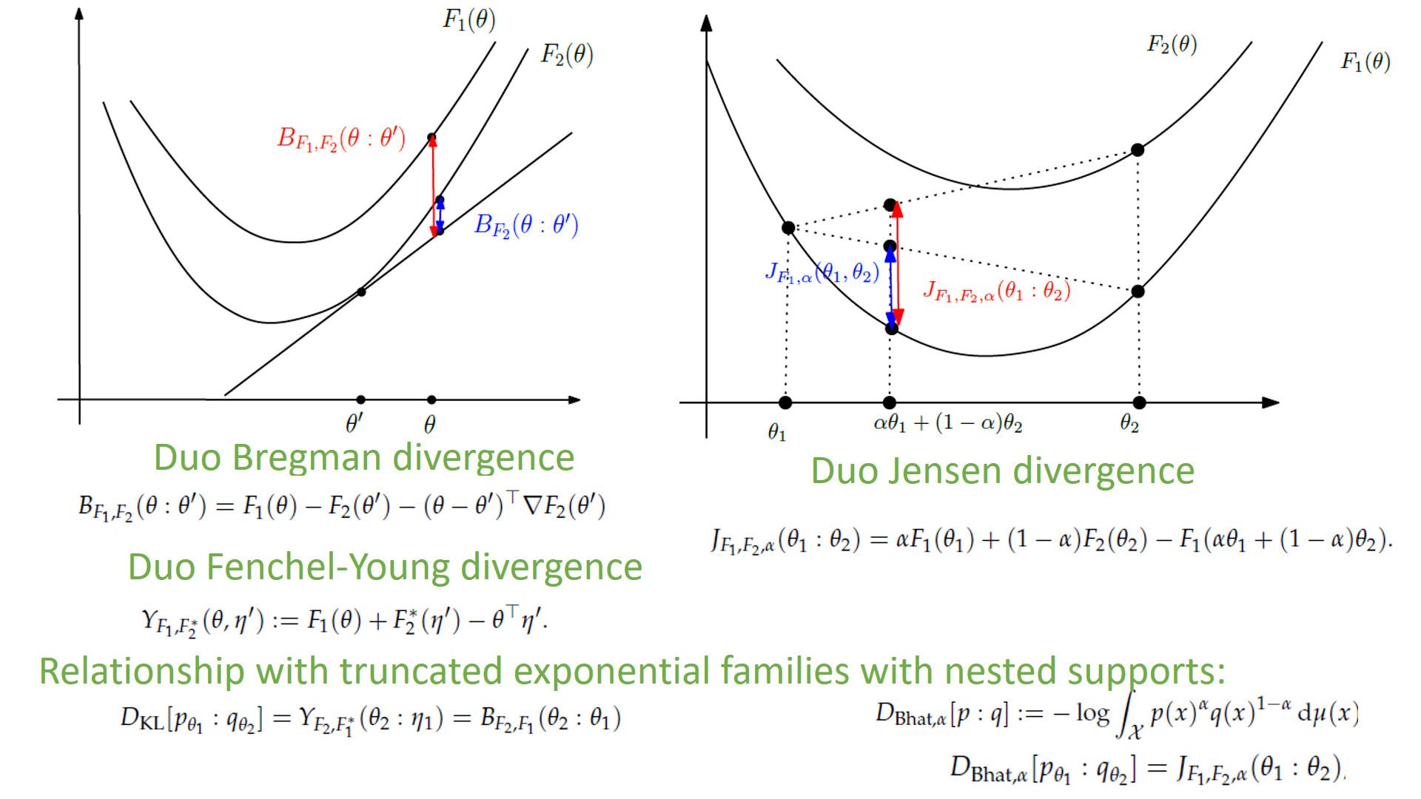
Duality
and
duo Fenchel-Young pseudo-divergences

Slide 20
Outline
A quick introduction to Bregman divergences
Duo Bregman pseudo-divergences
Curved Bregman divergences
Generalized Legendre transforms and information geometry
Generalized convexity and Bregman divergences
Space of Bregman balls
Notes:
Statistical divergence reconstruction from integral-based Bregman generators
(truncated exponential families)
(Hessian submanifolds)
(moduli space of dually flat spaces)

Slide 21
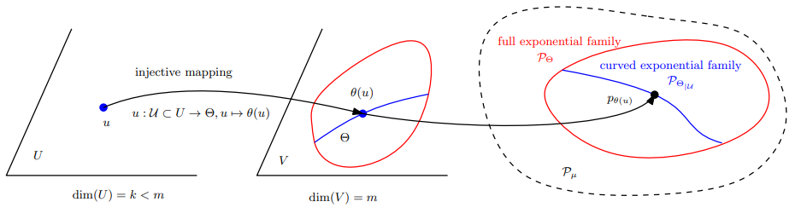
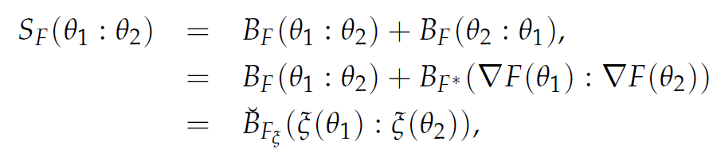
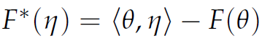
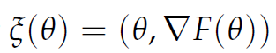
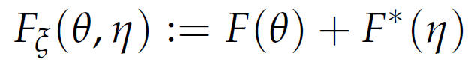
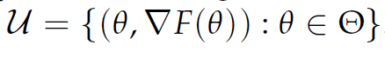
Curved Bregman divergences
Consider a domain U which maps
to a subset of Θ by θ =c(u) with dim(U) < dim(Θ) :
B_{F,c}(u₁ : u₂) := B_{F}(c(u₁ ):c( u₂)) is not Bregman when {c(u) | u ∈ U} not convex
usually not a Bregman divergence unless c(.) is affine
Example: Symmetrized Bregman divergences (= Jeffreys-Bregman div.) are curved Bregman divergences: S_{F}(θ₁ ,θ₂)=< θ₁ -θ₂ ,η₁ -η ₂ >
m-dimensional submanifold in 2m-dimensional space
(usually not cvx affine space, hence not a Bregman divergence)

Slide 22
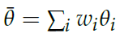
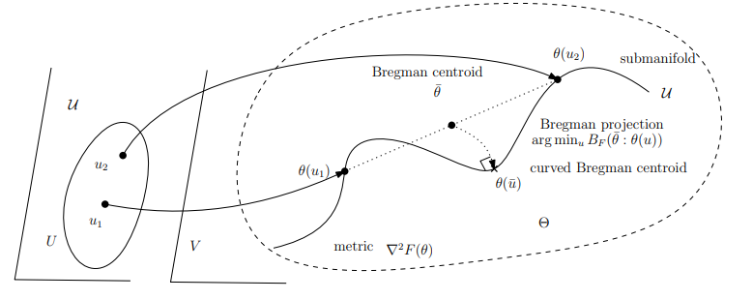
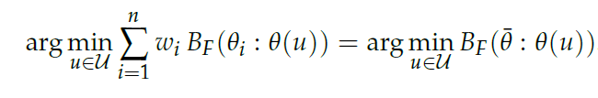
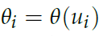
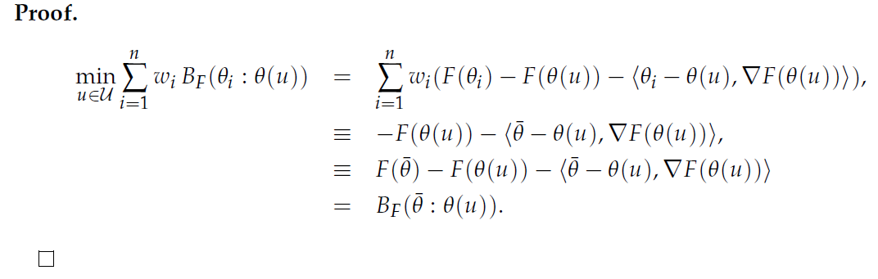
Curved Bregman centroid is the Bregman projection of the full Bregman centroid
Bregman projection
Theorem:
)
N-point opt.
One-point opt!
"What is... an information projection?" Notices of the AMS 65.3 (2018): 321-324.

Slide 23
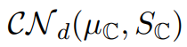
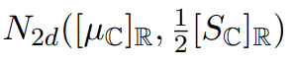
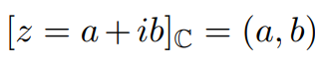
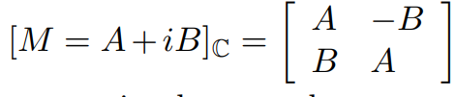
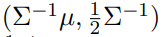
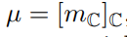
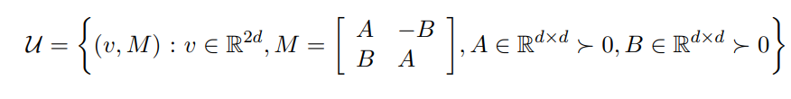
Another example of curved Bregman divergences:
Consider d-variate circular complex normal distributions
CNDs handled as 2d real normal distributions
Then KLD between CNDs amounts to a curved Bregman divergence:
Curved submanifold parameter in R^{2d} x Mat(2d)
Natural parameters
2504.05654

Slide 24
Outline
A quick introduction to Bregman divergences
Duo Bregman pseudo-divergences
Curved Bregman divergences
Generalized Legendre transforms and information geometry
Generalized convexity and Bregman divergences
Space of Bregman balls
Notes:
Statistical divergence reconstruction from integral-based Bregman generators
(truncated exponential families)
(Hessian submanifolds)
(moduli space of dually flat spaces)

Slide 25
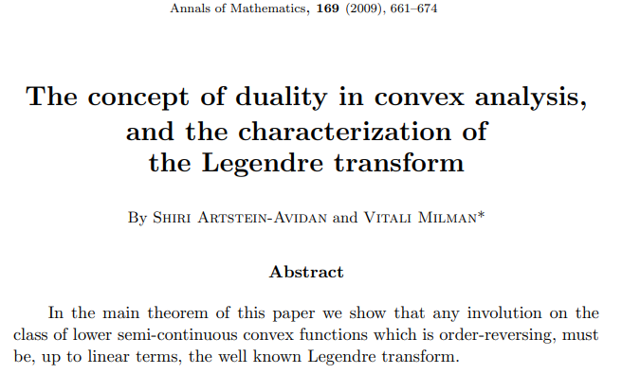
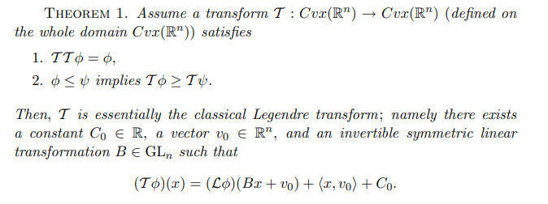
Generalized Legendre transforms (2009)

Slide 26
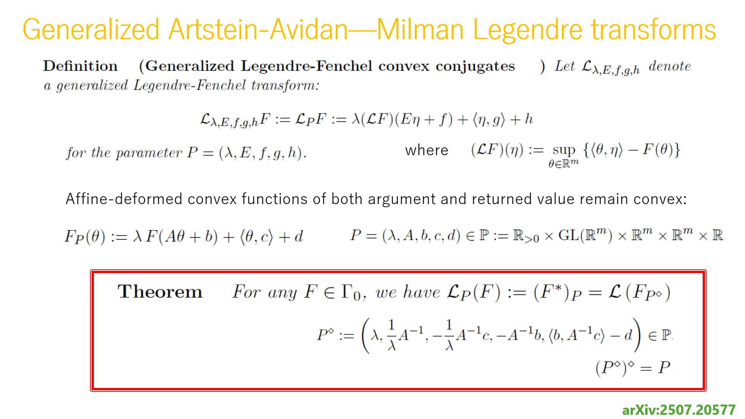
GLTs are LT on affinely deformed convex functions
Notes:
Theorem:
Reverse order involutive transformations are GLTs
Affine deformations preserve convexity!!

Slide 27
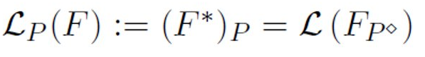
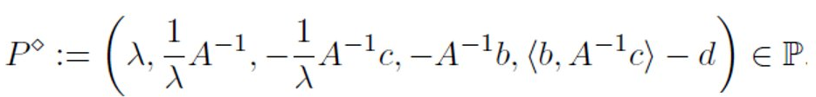
arXiv:2507.20577
Generalized Legendre transforms of functions
Amount to Legendre transforms on affinely deformed functions
arXiv:2507.20577

Slide 28
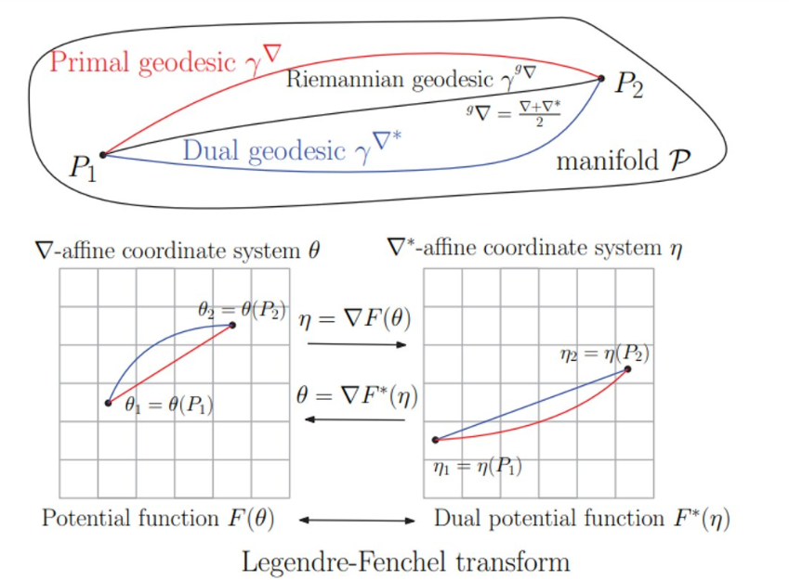
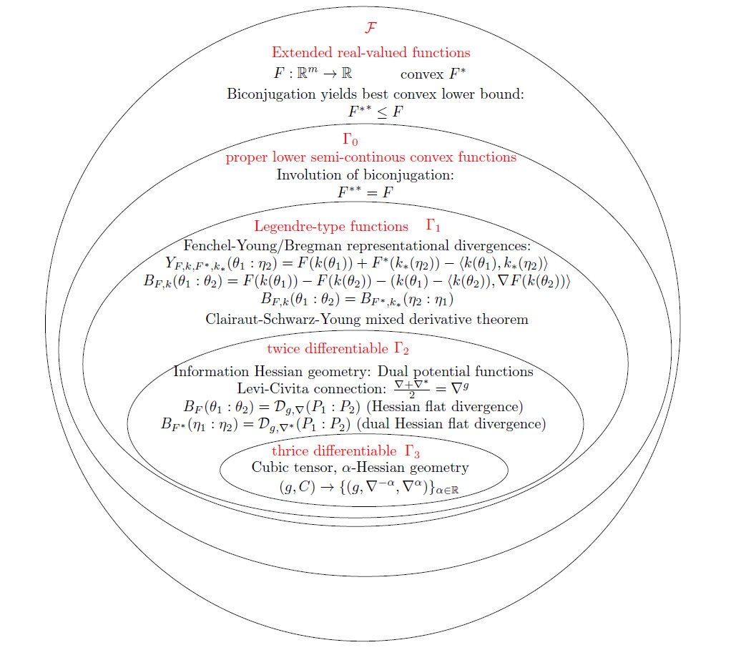
GLTs can be explained from information geometry
DO NOT READ!
For illustration purpose!
Two dualgeometric potential functions Φ and ψ on manifold
Dually flat spaces,
Hessian manifolds
Φ= ψ*
Degrees of freedom when reconstruction dual potential functions
Affine coordinate system up to affine transformation
Scaling of potential functions
Same geometric Legendre transform

Slide 29
Outline
A quick introduction to Bregman divergences
Duo Bregman pseudo-divergences
Curved Bregman divergences
Generalized Legendre transforms and information geometry
Generalized convexity and Bregman divergences
Space of Bregman balls
Notes:
Statistical divergence reconstruction from integral-based Bregman generators
(truncated exponential families)
(Hessian submanifolds)
(moduli space of dually flat spaces)

Slide 30
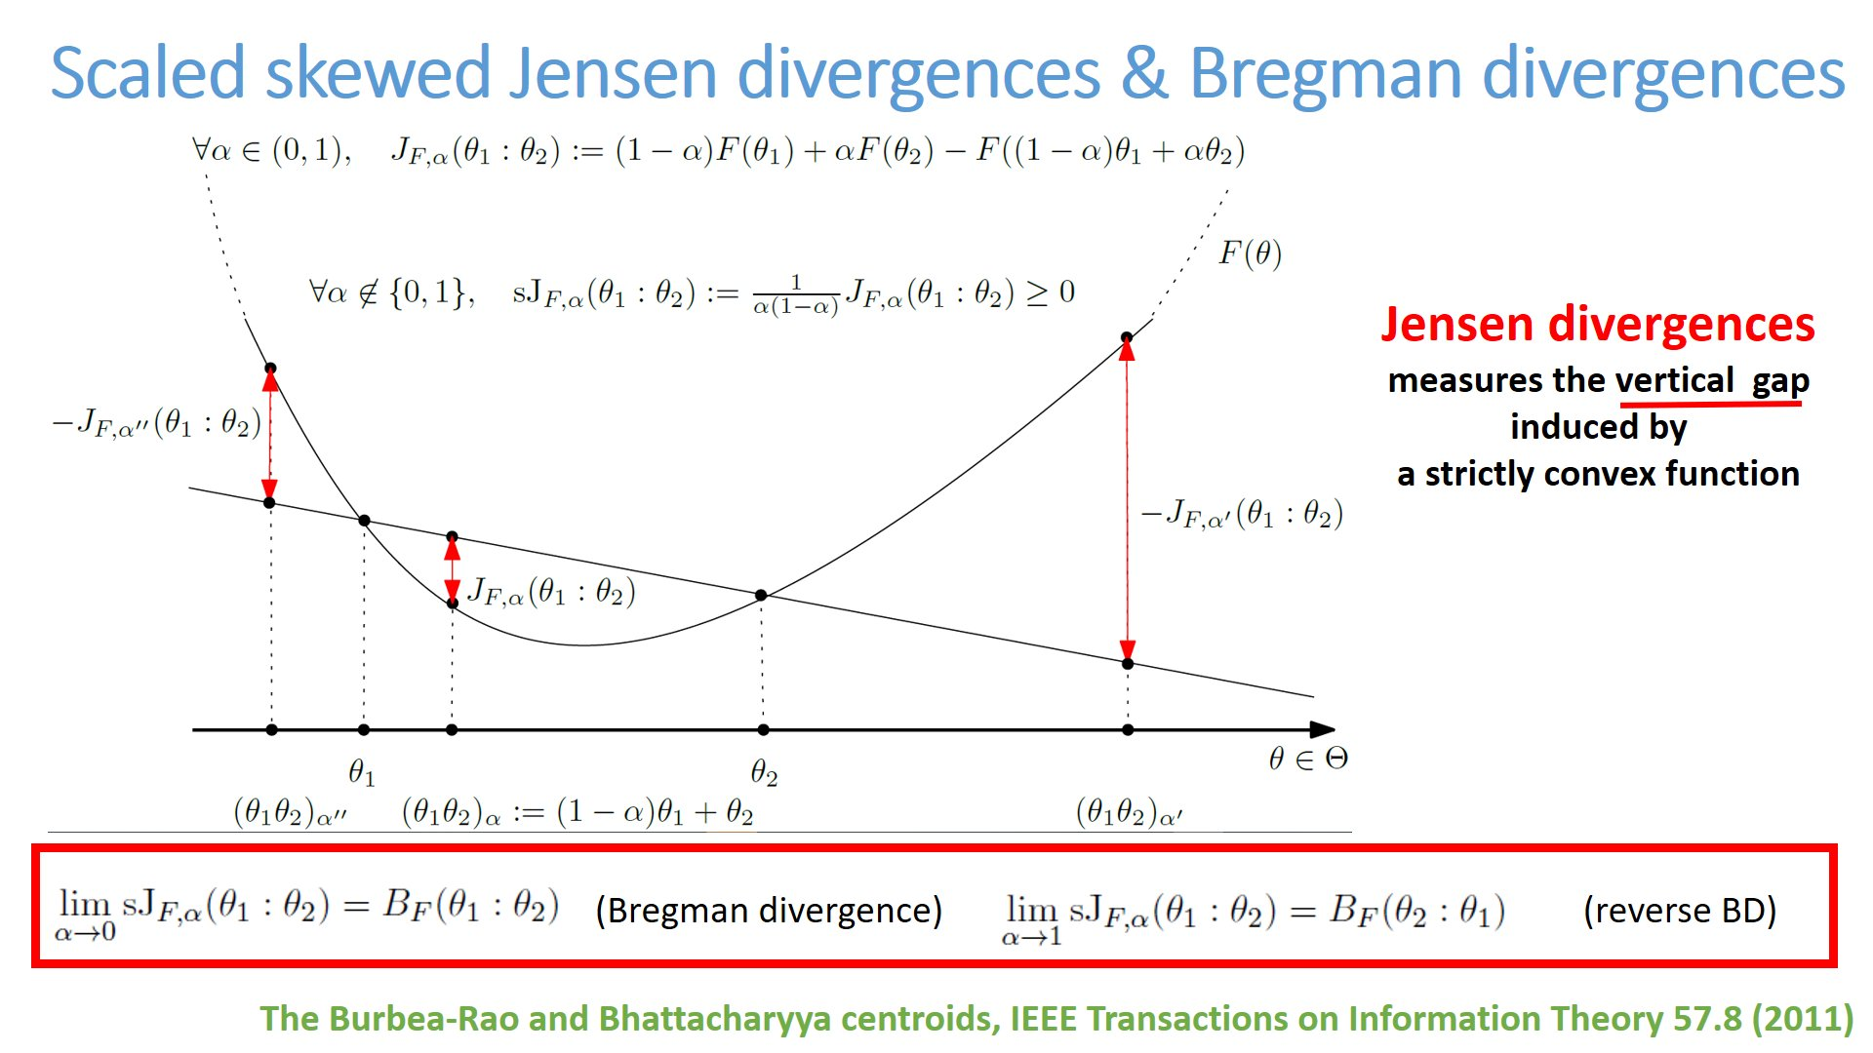
Bregman divergences: limits of scaled Jensen gaps
Rescale:

Slide 31
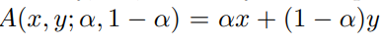
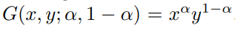
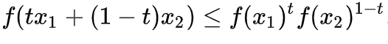
Comparative convexity: (M,N)-convexity
Ordinary convexity of a function:
for all t in [0,1]
Definition: A function Z is (M,N)-convex iff for in α in [0,1]:
Ordinary convexity = (A,A)-convexity wrt to arithmetic weighted mean
Log-convexity: (A,G)-convexity wrt to A/Geometric weighted means:
for all t in [0,1]
for all t in [0,1]
Since G ≤ A, (A,G)-functions are (A,A)-convex: Log-convex functions are convex

Slide 32
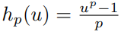
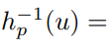
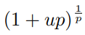
Comparative convexity wrt quasi-arithmetic means
quasi-arithmetic mean for a strictly monotone generator h(u):
Includes power means which are homogeneous means:
Include the geometric mean in the limit case p→0
Checking comparative convexity wrt two quasi-arithmetic means via an ordinary convexity test:

Slide 33
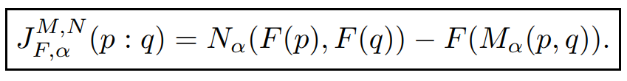

Generalizing Bregman divergences with (M,N)-convexity: (M,N)-Bregman divergences
First, define skew Jensen divergence from (M,N)-comp. convexity:
Non-negative for (M,N)-convex generators F, provided
regular means M and N (e.g. all power means)
Definition:
This definition is by analogy to limit of scaled skewed Jensen divergences
amount to forward/reverse Bregman divergences.

Slide 34



Generalizing Bregman divergences with quasi-arithmetic mean convexity
From 1st order
Taylor expansion…
Amounts to a conformal representational Bregman divergence :
With convex generator:
Conformal factor
Remark: Conformal Bregman divergences may yield robustness in applications
Shape retrieval using hierarchical total Bregman soft clustering, IEEE Transactions on pattern analysis and machine intelligence (2012)

Slide 35
Outline
A quick introduction to Bregman divergences
Duo Bregman pseudo-divergences
Curved Bregman divergences
Generalized Legendre transforms and information geometry
Generalized convexity and Bregman divergences
Boolean algebra of Bregman balls
Notes:
Statistical divergence reconstruction from integral-based Bregman generators
(truncated exponential families)
(Hessian submanifolds)
(moduli space of dually flat spaces)

Slide 36


Space of Bregman balls
Example:
Itakura-Saito right and left spheres
Right-sided Bregman ball:
≤
Left-sided Bregman ball:
≤
Application: Boolean algebra of unions & intersections of Bregman balls

Slide 37





Lifting to potential Bregman generator graph & vertical projection
Right Bregman ball and its complement
↓ means vertical projection
S^{c}: complement of set S
To any sphere, associate a hyperplane:
Reciprocally, to a hyperplane cutting the
function graph, associate a sphere
Center:
Radius:

Slide 38

Intersection of two right Bregman balls
Boolean algebra:
intersection of spheres

Slide 39

Union of two right Bregman balls
Boolean algebra:
Union of spheres
Set Morgan’s law: (A ∪ B)^{c} = A^{c} ∩ B^{c}
Complement of halfspace (H⁺)^{c}=H⁻
Notes:
De Morgan laws for sets

Slide 40


Example: Euclidean spheres potential function: Paraboloid, L22
Top view displays the union of disks
B_{F}(θ₁ : θ₂)=F(θ₁)-F(θ₂)-< θ₁ - θ_{2 ,} ∇F(θ₂) >
Well-known “paraboloid transform” in computational geometry
Used for computing (Bregman) Voronoi and dual Delaunay complex
Notes:
30 min: 25 transparents

Slide 41

Wrapping up
Quick introduction to Bregman divergences
⇒ BD wrt partition function Z = reconstructed stat. reverse extended KLD+
Duo Bregman pseudo-divergences
⇒ BD with 2 majorized generators, applications to KLD nested exp fams
Curved Bregman divergences
⇒ Symmetrized BD , KLD between circular complex normal, projection them
Generalized Legendre transforms and information geometry
⇒ Rev. order involut. transf. = affine-deform. LT=LT potential function on Hessian manifold
Generalized convexity and Bregman divergences
⇒ BDs = limits of scaled skew Jensen div., comparative cvxity, conformal factor
Space of Bregman balls , Boolean algebra of Bregman balls
⇒ Embedding into higher dim., Boolean operations = intersections of halfspaces
Notes:
Statistical divergence reconstruction from integral-based Bregman generators
(truncated exponential families)
(Hessian submanifolds)
(moduli space of dually flat spaces)

Slide 42






A Python library for geometric computing on Bregman Manifolds
pyBregMan
https://franknielsen.github.io/pyBregMan/
Chernoff point
Jensen-Shannon centroid
Inductive AHM mean
Geometric matrix mean
Bregman/Jensen centroids
Joint work of Frank Nielsen and Alexander Soen

Slide 43

Yet further generalizations…
representational Bregman divergence
curved Bregman divergence
total Bregman divergence
conformal Bregman divergence
duo pseudo-Bregman divergence
matrix Bregman divergence
comparative-convexity Bregman divergence
chord Bregman divergence
tangent Bregman divergence
Bregman-Chernoff divergence
Jensen-Bregman divergence
quasi-convex Bregman divergence
Symplectic Bregman divergence
Symmetrized Bregman divergence
Bregman divergence

Slide 44



Thank you!
Geometric Science of Information conference:
https://franknielsen.github.io/GSI/
Slides: https://franknielsen.github.io/MML25.pdf

Slide 45
Some references
A quick introduction to Bregman divergences
Divergences Induced by the Cumulant and Partition Functions of Exponential Families and Their Deformations Induced by Comparative Convexity. Entropy 26(3): 193 (2024)
Duo Bregman pseudo-divergences
Statistical Divergences between Densities of Truncated Exponential Families with Nested Supports: Duo Bregman and Duo Jensen Divergences. Entropy 24(3): 421 (2022)
Curved Bregman divergences
Curved representational Bregman divergences and their applications. 2504.05654 (2025)
Generalized Legendre transforms and information geometry
A note on the Artstein-Avidan-Milman's generalized Legendre transforms. 2507.20577 (2025)
Generalized convexity and Bregman divergences
Generalizing Skew Jensen Divergences and Bregman Divergences With Comparative Convexity. IEEE Signal Process. Lett. 24(8): 1123-1127 (2017)
Space of Bregman balls
Bregman Voronoi Diagrams. Discret. Comput. Geom. 44(2): 281-307 (2010)
Notes:
Statistical divergence reconstruction from integral-based Bregman generators
(truncated exponential families)
(Hessian submanifolds)
(moduli space of dually flat spaces)

Slide 46


Slide 47
Outline of this talk
A quick introduction to Bregman divergences
Duo Bregman pseudo-divergences
Curved Bregman divergences
Generalized Legendre transforms and information geometry
Generalized convexity and Bregman divergences
Space of Bregman balls
Notes:
Statistical divergence reconstruction from integral-based Bregman generators
(truncated exponential families)
(Hessian submanifolds)
(moduli space of dually flat spaces)

Slide 48
Representational Bregman divergences (2009)
Use a representation function R :
B_{F,R}(λ ₁ : λ ₂):= B_{F}(R(λ ₁ ):R(λ ₂))
= F(R(λ ₁))-F(R(λ ₂))-< R(λ ₁)–R(λ ₂ ),∇F(R(λ ₂) ) >
Note that F∘R may not be a Bregman generator, i.e., not be strictly convex.
For example, consider the KLD between two densities of a generic exponential family (natural parameter from representation function)
θ(λ ): natural parameter corresponding to λ, representation function R(.)=θ(. )
include normal, Gamma/Beta, Wishart, Poisson, etc.
D_{KL}[p(x| λ ₁) : p(x| λ ₂) ] = B_{F}^{rev}(θ (λ ₁): θ (λ ₂))=B_{F}(θ (λ ₂): θ (λ ₁))
NEF density p(x| θ) ∝ exp(<x, θ >)
D_{KL}[p(x|θ₁) : p(x|θ₂) ] = B_{F}^{rev}(θ₁ : θ₂) = B_{F}(θ₂ : θ₁)
Notes:
Λ
A *representational Bregman divergence* is a Bregman divergence applied on a representation of the parameter space.
The α-divergences extended positive measures are an example of representational Bregman divergences.
Dual representational Fenchel-Young divergence with dual representation function
But restricted to the (m-1)-dimensional probability simplex is not a
Nielsen, Frank, and Richard Nock.
"The dual Voronoi diagrams with respect to representational Bregman divergences." IEEE ISVD 2009

Slide 49




Extendedα-divergences are representational BDs
α-divergences extended to m-dimensional positive measures
are representational Bregman divergences:
Bregman generator:
Representation function:
Bregman divergence:
B_{F}(θ₁ : θ₂)=F(θ₁)-F(θ₂)-< θ₁ - θ_{2 ,} ∇F(θ₂) >
"The dual Voronoi diagrams with respect to representational Bregman divergences." IEEE ISVD 2009

Slide 50




BDs: Versatile and popular in OR, ML, IT, signal processing
Originally motivated for finding an intersection point in a set of convex objects using Bregman projections.
(ex. of convex objects: halfspaces, balls, etc.)
BDs unify:
squared Euclidean divergence F(θ)= ½ Σ_{i} <θ, θ >
Kullback-Leibler divergence F(θ)= Σ_{i} θ_{i} log(θ_{i}) (relative Shannon entropy)
Itakura-Saito divergence F(θ)= Σ_{i} -log(θ_{i})
(relative Burg entropy)
B_{F}(θ₁ : θ₂)=F(θ₁)-F(θ₂)-< θ₁ - θ_{2 ,} ∇F(θ₂) >
L22 (β=2), KLD (β→0), ISD (β=1), belong to a family of β-divergences, learn ad hoc β ≥ 0
Bregman
Generator:
x,y>0, β ≥ 0

Slide 51


Slide 52




Bregman divergences and Jensen divergences Cumulant functions/Partition functions
F(θ)=log Z(θ) ↔ Z(θ)=exp(F(θ))
①
②
And furthermore, we can define skewed Jensen divergences from the convex generators:
①
②
Including the symmetric Jensen divergence when 𝛼=1/2:
Notes:
We can reconstruct statistical divergences from those BDs:
① ② ③

Slide 53

KLD/α-Bhattacharyya ⇔ Bregman/Jensen divergences when considering exponential families, F cumulant function
Jensen divergence
Approximate BD with JD forα=ε≅0
Bregman divergence
Question: What are the reconstructed statistical divergences from Jensen-Bregman divergence J_{Z} / B_{Z}?
Z: partition function
Zhang, Divergence function, duality, and convex analysis, Neural computation 16.1 (2004)
N + Boltz. "The Burbea-Rao and Bhattacharyya centroids." IEEE Transactions on Information Theory (2011)
Notes:
Zhang, Divergence function, duality, and convex analysis, Neural computation 16.1 (2004)
N and Boltz. "The burbea-rao and bhattacharyya centroids." IEEE Transactions on Information Theory 57.8 (2011)
α=ε≅0

Slide 54



Slide 55
Some generalizations and perspectives on Bregman divergences
In this talk, we first present some generalizations and perspectives of Bregman divergences with applications ranging from statistics to machine learning and information theory. Namely, we describe representational Bregman divergences, curved Bregman divergences, total Bregman divergences, duo pseudo-Bregman divergences, and comparative convexity Bregman divergences. Second, we describe the space of Bregman balls and spheres and show how it is algorithmically convenient to solve various problems.
https://franknielsen.github.io/BregmanDivergence/index.html
Notes:
https://franknielsen.github.io/BregmanDivergence/index.html

